Slide 1
Chapter 1 Introduction to Python Programming
By
Hyung Jae (Chris) Chang
Troy University

Slide 2
Ways to rung Python Code
Installation of Python and related packages
Anaconda: a complete distribution framework that includes the Python interpreter, package manager and the commonly used packages in scientific computing.
Miniconda: a “light” version of Anaconda that does not include the commonly used packages. You need to install all the different packages yourself, but it does include the Python interpreter and package manager.
Ways to run Python code
Python shell or Ipython shell (which stands for Interactive Python)
Run a Python script/file from the command line (.py)
Use browser-based Python environment which is called Jupyter Notebook
Use IDEs of your choice, such as Spyder or PyCharm.

Slide 3
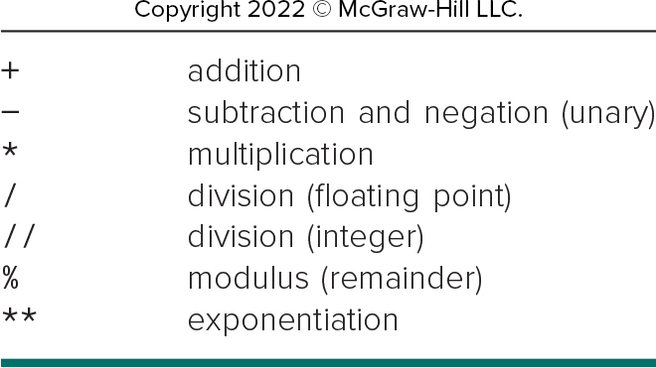
Python as Calculator
Arithmetic operation calculated and returning answer
Open up Python console and try the followings
1+2
5-4
29*23
15/3
2**10
How about (3x4)/(2²+4/2)?

Slide 4
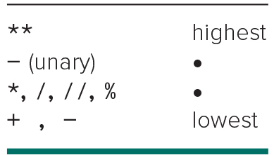
Python as Calculator (cont.)
Let’s try more!
(55² + 2/3)/(13²)
The computations are following the mathematical precedence.
Parenthesis can be used to change the order of operation.
“_” is used to break the complex computations.
Please try the followings in the Command Prompt
55**2
_+2/3
_/13**2

Slide 5

Math Module
Python has many basic arithmetic functions like sin, cos, tan, asin, acos, atan,exp, log, log10 and sqrt.
These are used by importing “math” module
Type “import math” to import math module.
math.sqrt(4): square root of 4 → square root function from math module
math.pi: pi value in math → 3.14259265359…
math.sin(math.pi/2): sin function
What do you see? We will discuss about it later.

Slide 6
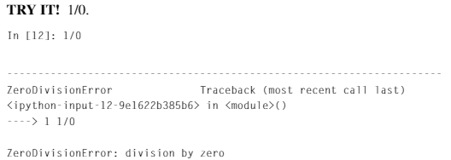
Math Module (cont.)
? in Python
Shortcut for help
Try “math.factorial?”
ZeroDivisionError
Python raises such an error when the expression 1/0 (which is infinity) appears.

Slide 7
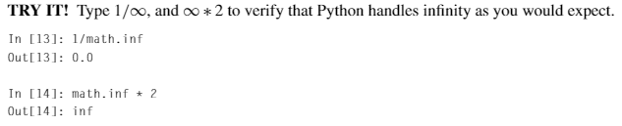

Math Module (cont.)
Infinite number → math.inf

Slide 8

Math Module (cont.)
Complex numbers can be represented
A complex number: c=a+bi with real part a, imaginary part b and imaginary unit i=$√$-1.
In Python, the symbol j is used to denote the imaginary unit.
2+5i → 2+5j
Or we can use a constructor complex
complex (2, 5)
Scientific notation using the letter e
Python can handle scientific notation
1e6 = 1000000
1e-3 = 0.001

Slide 9
Math Module (cont.)
Every time a function in math module is typed, it is always typed math.function_name.
Alternatively, there is a simpler way. For example, if we want to use sin and log from math module, we can import them as follows: “from math import sin, log”.

Slide 10
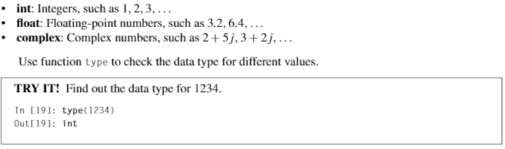


Data Types
In Python, there are additional data types needed for numerical values: int, float and complex.

Slide 11
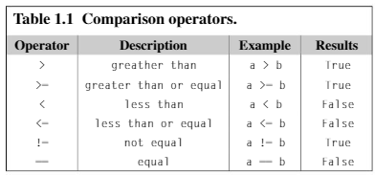
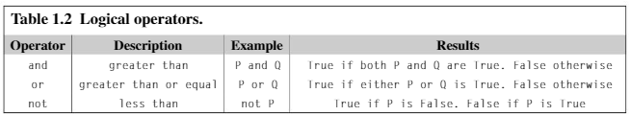
Logical Expressions and Operators
Logical Expression → True or False
We can construct truth tables for each logical operator.

